Slide 1

Consumer Goods
Ad_hoc Insights

Slide 2
Agenda
Objectives
Customer Analysis/Overview
Sales Overview
Product Inventory/Performance
Q&A

Slide 3
Objective
get an overview on sales by examining customer behavior, product performance, and the overall sales trend.
Track our growth in sales and production.

Slide 4
Customer Analysis/Overview

Slide 5
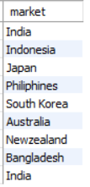
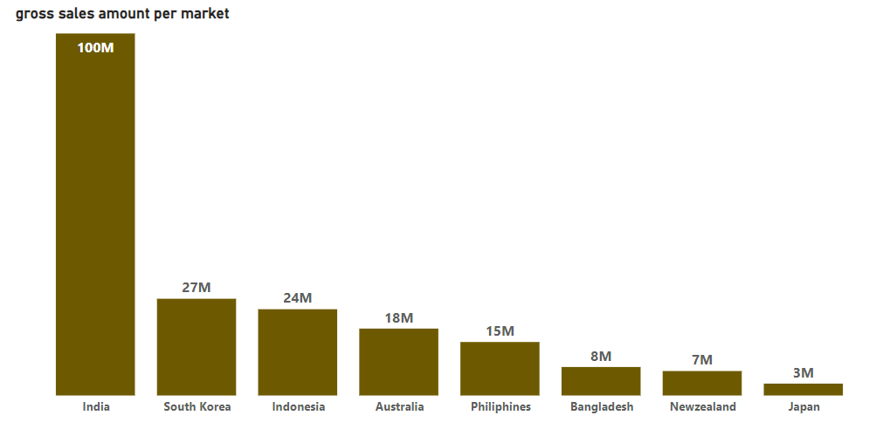
Markets where "Atliq Exclusive" operates, in the APAC region.

Slide 6
Insights
India accounts for roughly 50% of our sales to this customer in the APAC region
we should look to improve our presence in the last three regions, as our products might not be as competitive there.

Slide 7
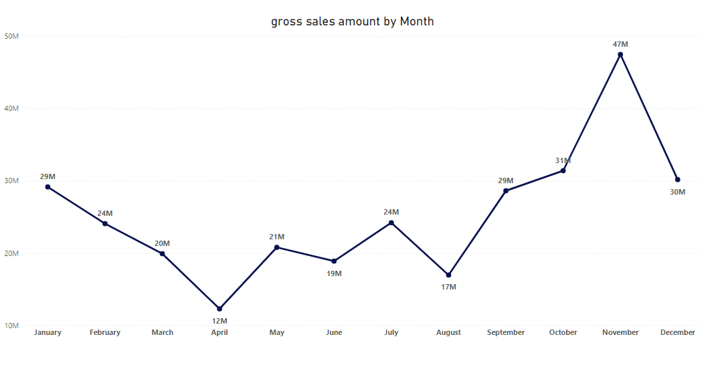
Gross revenue generated from “Atliq Exclusive” for each month

Slide 8
Insights
The least amount of Sales were generated in April and August.
We had the most sales in November.
Recommendations:
special discounts and promotions, might help boost sales in april and august.

Slide 9
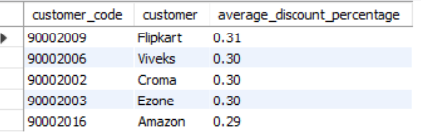
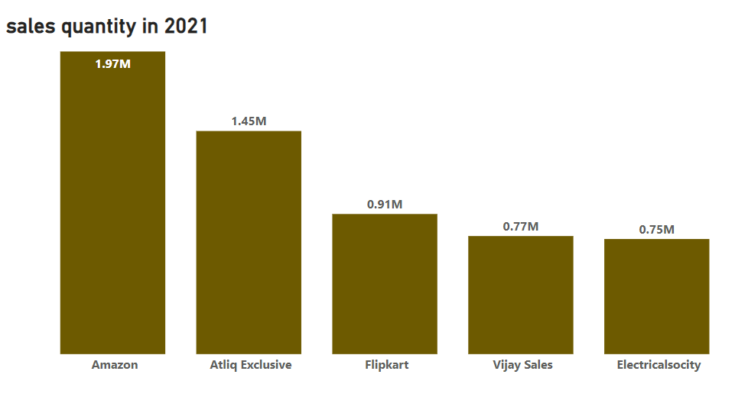
Top 5 average_discount_percentage for 2021 in the Indian market

Slide 10
Insights
Viveks, Croma, and Ezone are not among our top 5 premium customers, yet they enjoy our premium discounts.
Check if these customers meet other requirements that warrant a discount.
Prioritize our premium customers.

Slide 11
Sales Overview

Slide 12
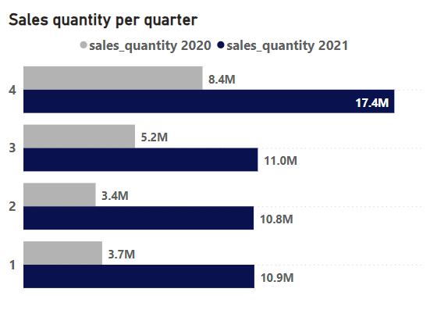
Sales quantity per quarter 2020 vs. 2021
we see a massive improvement in sales for every quarter in 2021

Slide 13
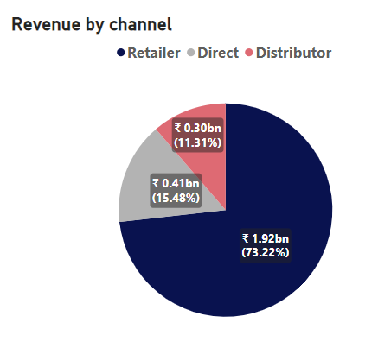
Which channel generated the most Revenue in 2021

Slide 14
Product Inventory/Performance

Slide 15
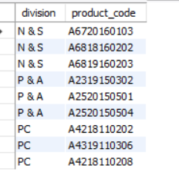
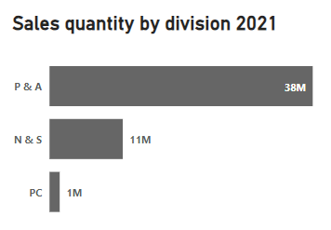
Top 3 products sold in 2021 by divisio﻿n

Slide 16
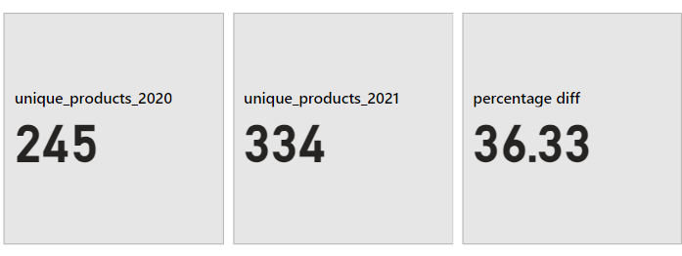
Percentage of uniq﻿ue product increase in 2021 vs. 2020

Slide 17
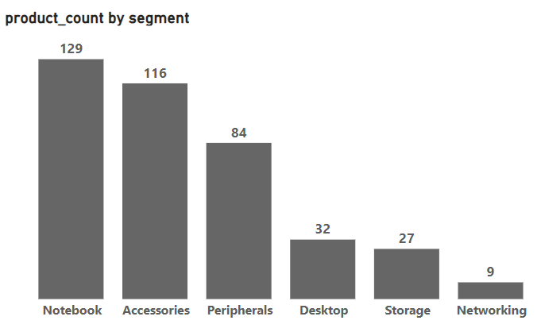
An inventory of our unique products per segment

Slide 18
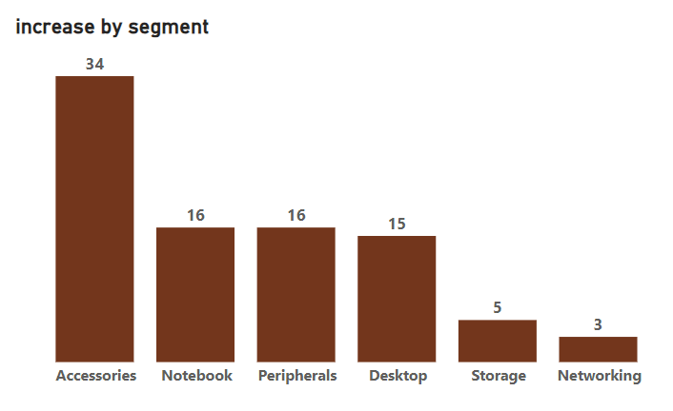
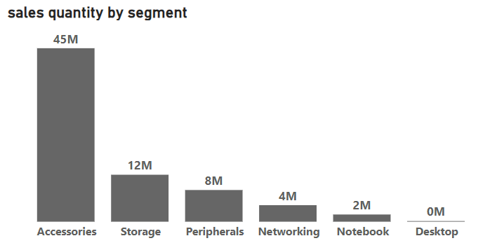
Which segment had the most increase in unique products in 2021 vs 2020

Slide 19
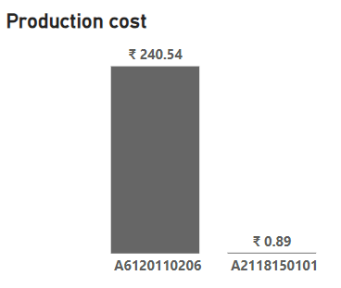
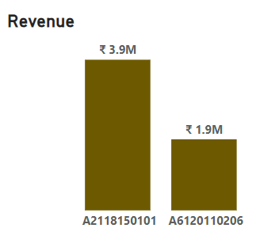
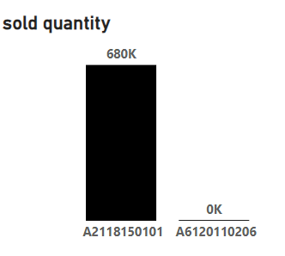
What are our most Expensive and Cheapest products to pr﻿oduce?

Slide 20


Thank you
Feel free to ask questions

